Slide 1
HEART DISEASE PREDICTION SYSTEM
G. SAI KEERTHANA(18X01A05D9)

Slide 2
CONTENTS :
Abstract
Introduction
Existing System
Proposed System
Technology used
Architecture
System Requirements, Dataset
Module Description
Use Case Diagram
Test cases
Design model
Screenshots
Conclusion

Slide 3
ABSTRACT:
Heart plays significant role in living organisms.
Diagnosis and prediction of heart related diseases requires more precision, perfection and correctness because a little mistake can cause fatigue problem or death of the person, there are numerous death cases related to heart and their counting is increasing exponentially day by day.
To deal with the problem there is essential need of prediction system for awareness about diseases.
Machine learning is the branch of artificial intelligence(ai), it provides prestigious support in predicting any kind of event which take training from natural events.
In this paper, we calculate accuracy of machine learning algorithms for predicting heart disease, for this algorithms are K-Nearest Neighbour, Random Forest Regression, XG Boost, Light GBM and support vector machine(svm) by using UCI repository dataset for training and testing.

Slide 4
INTRODUCTION:
Heart disease is a kind of disease which effects the functioning of the heart. In today’s era heart disease is the primary reason for deaths. WHO-World Health Organization has anticipated that 12 million people die every year because of heart diseases.
Some heart diseases are cardiovascular, heart attack, coronary and knock. Knock is a sort of heart disease that occurs due to strengthening, blocking or lessening of blood vessels which drive through the brain or it can also be initiated by high blood pressure.
The major challenge that the Healthcare industry faces now-a-days is superiority of facility. Diagnosing the disease correctly & providing effective treatment to patients will define the quality of service.
Different person body can show different symptoms of heart disease which may vary accordingly. Though, they frequently include back pain, jaw pain, neck pain, stomach disorders, and tininess of breathe, chest pain, arms and shoulders pains. There are a variety of different heart diseases which includes heart failure and stroke and coronary artery disease.

Slide 5
EXISTING SYSTEM:
Heart related infections or Cardiovascular Diseases (CVDs) are the primary justification a large number of death on the planet in the course of the most recent couple of many years and has arisen as the most illness, in India as well as in the entire world.
AI calculations and methods have been applied to different clinical datasets to robotize the investigation of enormous and complex information.
Numerous scientists, as of late, have been utilizing a few AI procedures to help the medical care industry and the experts in the analysis of heart related illnesses.

Slide 6
PROPOSED SYSTEM:
We smooth out AI calculations for powerful expectation of constant illness episode in disease-continuous networks. We try the adjusted expectation models over genuine medical clinic data collected from focal China in 2013–2015.
To deal with the problem there is essential need of prediction system for awareness about diseases. Machine learning is the branch of Artificial Intelligence(AI), it provides prestigious support in predicting any kind of event which take training from natural events.
we calculate accuracy of machine learning algorithms for predicting heart disease, for this algorithms are Random forest, XG boost, K-NN, Light GBM by using UCI repository dataset for training and testing.

Slide 7

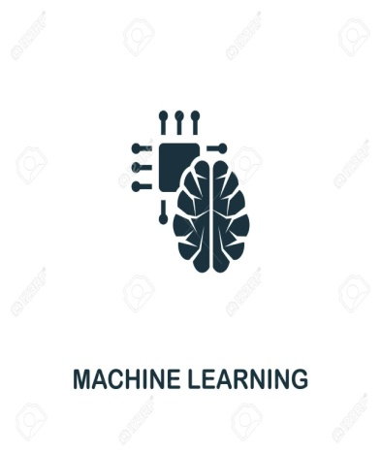
TECHNOLOGY USED :
PYTHON LANGUAGE
AI MACHINE LANGUAGE
Python is a very powerful programming language used for many different applications. Over time, the huge community around this open source language has created quite a few tools to efficiently work with Python.
AI Machine learning is the scientific study of algorithms and
Statistical models that computer systems use in order to perform a specific task effectively without using explicit instructions, relying on patterns and inference instead. It is seen as a subset of artificial intelligence
PYTHON
AI MACHINE
LANGUAGE

Slide 8
ARCHITECTURE :
Input Data: The dataset that contains the person attributes are entered.
Preprocessing: Process of preparing the raw data and making it suitable for a machine learning model.
Train Data: After collecting the data from the patient into the dataset, then it trains the data.
Test Data: It tests the data using various algorithms or mechanisms such as KNN , decision tree , etc.
After testing the data it predicts the disease present or not.

Slide 9
SYSTEM REQUIREMENTS :
HARDWARE REQUIREMENTS:
System : MINIMUM i3
Hard Disk : 40 GB
Ram : 4 GB
SOFTWARE REQUIREMENTS:
Operating System: Windows 8
Coding Language : Python 3.7

Slide 10
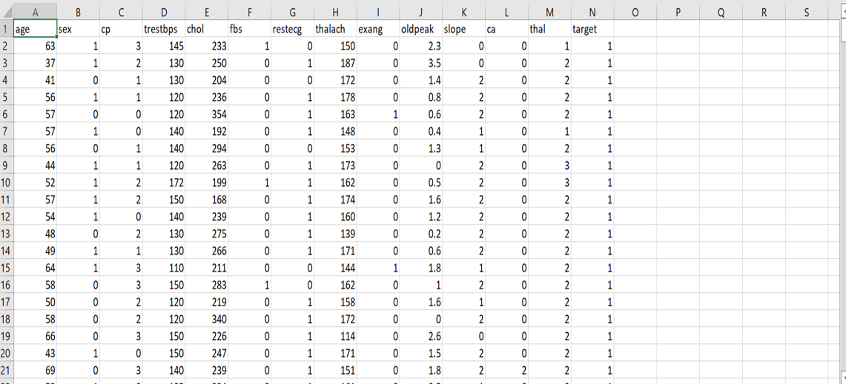
DATASET :
In the dataset the rows contain the data of person’s age, cp, trestbps, chol, fbs, restecg, thalach, exang, oldpeak, slope, ca, thal etc.

Slide 11
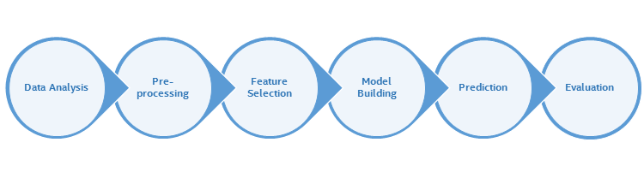
MODULE DESCRIPTION :
The methodology, depicted in the following figure, has been adopted for conducting liver patient dataset classification experiment.

Slide 12
Data Pre-processing :
Data pre-processing is a process of preparing the raw data and making it suitable for a machine learning model. It is the first and crucial step while creating a machine learning model.
Data pre-processing is required tasks for cleaning the data and making it suitable for a machine learning model which also increases the accuracy and efficiency of a machine learning model.
Feature Description :
Feature selection is mainly applied to large datasets to reduce high dimensionality. This helps to identify the most important features in the dataset that can be given for model building. In the Indian Liver Patient dataset, the logistic regression algorithm is applied in order to visualize feature importance.

Slide 13
Model Description :
A list of classifiers was used for creating various classification models, which can be further used for prediction. A part of the whole dataset was given for training the model and the rest was given for testing.
Evaluation of model :
Several methods can be used to evaluate the performance of the model. Cross validation, confusion metrics, accuracy and so on are some of the popular performance evaluation measures.
The performance of a model cannot be assessed by considering only the accuracy, because there is a possibility for misleading. Therefore this experiment considers the F1 score along with the accuracy for evaluation.

Slide 14
USE CASE DIAGRAM :
A use case diagram in the Unified Modeling Language (UML) is a type of behavioral diagram defined by and created from a Use-case analysis. The main purpose of a use case diagram is to show what system functions are performed for which actor. Roles of the actors in the system can be depicted.
Train Machine Learning Algorithm on Heart Disease
Predict Heart Disease
Logout

Slide 15
TEST CASES :
Module : Heart disease prediction
Status: Yes or No
Test data: Test the dataset
Summary: To predict the heart disease
Dataset Attributes | Domain Values | Test Data | Status
Age | 29 to 77 | Success | Yes
Sex | Male(1) / Female(0) | Success | Yes
CP | Typical angina(0) Atypical angina(1) | Failure | No
Chol | Non-angina(0) Asymptomatic(1) | Success | Yes
Ca | Serum cholesterol(126 to 564 mg/dl) | Failure | No
Thal | 0-3 Normal(3) Fixed defect(6) | Failure | No
Num | Reversible effect(7) 0-4 | Success | Yes

Slide 16
Random Forest:
DESIGN MODEL :
Types of Models Used
It comes under the category of ensemble methods. It employs ‘bagging’ and ‘boosting’ methods to draw a random subset from the data, and train a Decision Tree on that (hence, the name Random Forest)
XGBoost:
It is a perfect combination of software and hardware optimization techniques to yield superior results using less computing resources in the shortest amount of time. The beauty of this powerful algorithm lies in its scalability, which drives fast learning through parallel and distributed computing and offers efficient memory usage.
Random
Forest
XGBoost
Knn
LightGBM

Slide 17
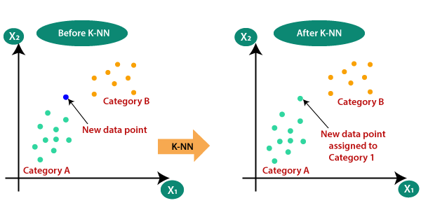
Knn :
K-Nearest Neighbour is one of the most basic yet essential classification algorithms in Machine Learning. It belongs to the supervised learning domain and finds intense application in pattern recognition, data mining and intrusion detection.
K-NN algorithm stores all the available data and classifies a new data point based on the similarity. This means when new data appears then it can be easily classified into a well suite category by using K- NN algorithm.
LightGBM:
It is a gradient boosting framework that makes use of tree based learning algorithms that is considered to be a very powerful algorithm when it comes to computation. It is considered to be a fast processing algorithm. LightGBM is called “Light” because of its computation power and giving results faster. It takes less memory to run and is able to deal with large amounts of data.

Slide 18
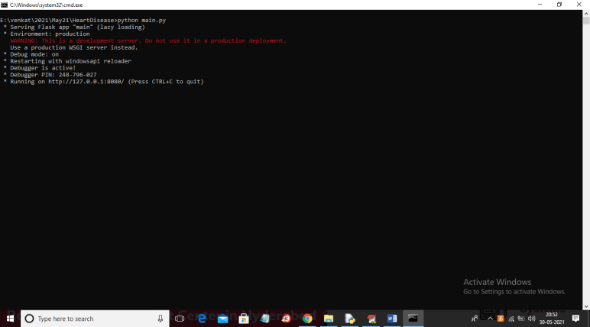
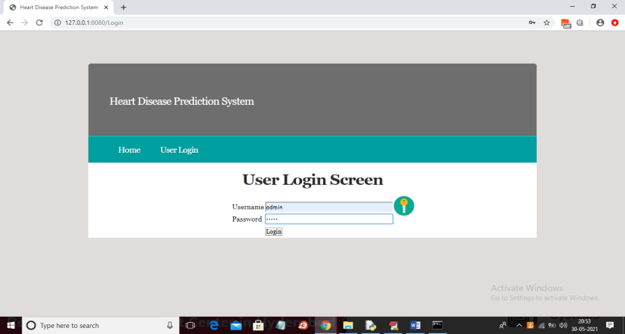
SCREENSHOTS :
1.To run project double click on ‘run.bat’ file to start FLASK screen.
2.In above screen FLASK server started and now open browser and enter URL as ‘http://127.0.0.1:8080/index’ and press enter key to get below home page.
3.In above screen click on ‘User Login’ to get below screen.

Slide 19
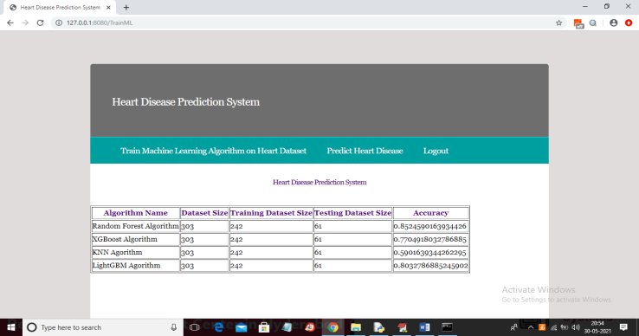
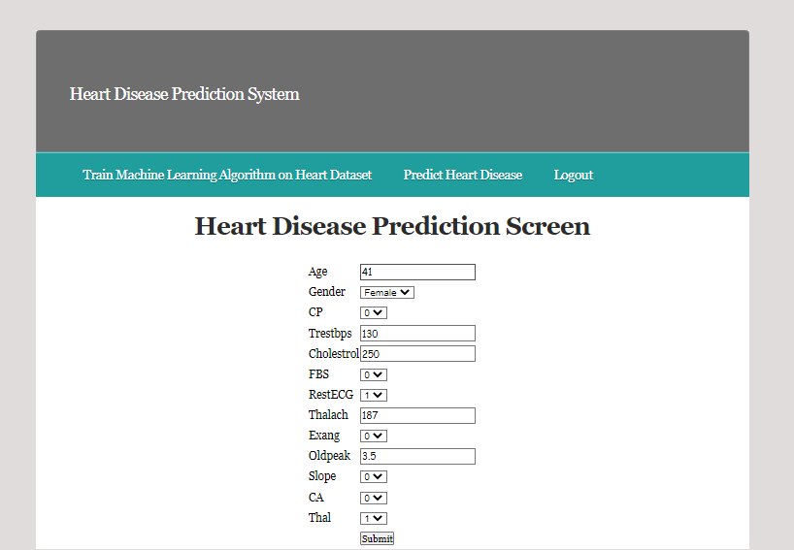
SCREENSHOTS :
5.In above screen user will enter details about his/her heart and application will predict disease.
4.In above screen click on ‘Train Machine Learning Algorithm on Heart Dataset’ link to train all machine learning algorithms.

Slide 20
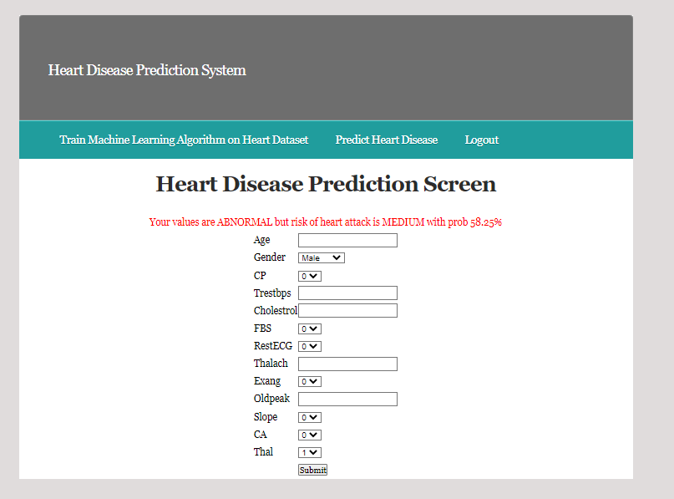
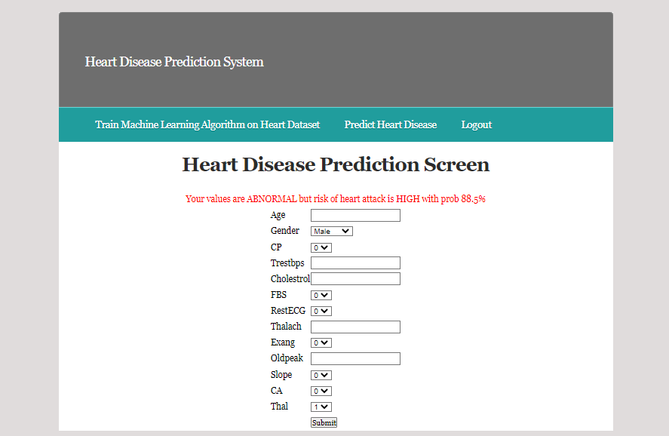
SCREENSHOTS:
6.The prediction is done with the probability rate of heart disease.
7.Prediction is done with different datasets.

Slide 21
CONCLUSION :
This presents a survey of various models based on such algorithms and techniques and analyze their performance.
Heart related diseases or Cardiovascular Diseases (CVDs) are the main reason for a huge number of death in the world over the last few decades and has emerged as the most life-threatening disease, not only in India but in the whole world.
So, there is a need of reliable, accurate and feasible system to diagnose such diseases in time for proper treatment.

Slide 22
FUTURE ENHANCEMENTS:
Machine Learning algorithms and techniques have been applied to various medical datasets to automate the analysis of large and complex data.
Many researchers, in recent times, have been using several machine learning techniques to help the health care industry and the professionals in the diagnosis of heart related diseases.
This presents a survey of various models based on such algorithms and techniques and analyze their performance.

